Slide 1

Chapter 18 – Generic Classes

Slide 2

Chapter Goals
To understand the objective of generic programming To implement generic classes and methods
To explain the execution of generic methods in the virtual machine
To describe the limitations of generic programming in Java

Slide 3
Generic Classes and Type Parameters
Generic programming: creation of programming constructs that can be used with many different types.
In Java, achieved with type parameters or with inheritance Type parameter example: Java's ArrayList (e.g.
ArrayList<String>)
Inheritance example: LinkedList implemented in Section 16.1 can store objects of any class
Generic class: has one or more type parameters.
A type parameter for ArrayList denotes the element type:
public void add(E element) public E get(int index)

Slide 4
Type Parameter
Can be instantiated with class or interface type:
ArrayList<BankAccount> ArrayList<Measurable>
Cannot use a primitive type as a type parameter:
ArrayList<double> // Wrong!
Use corresponding wrapper class instead:
ArrayList<Double>

Slide 5
Type Parameters
Supplied type replaces type variable in class interface. Example: add in ArrayList<BankAccount> has type variable E replaced with BankAccount:
public void add(BankAccount element)
Contrast with LinkedList.add from Chapter 16:
public void add(Object element)

Slide 6
Type Parameters Increase Safety
Type parameters make generic code safer and easier to read:
Impossible to add a String into an ArrayList<BankAccount>
Can add a String into a non-generic LinkedList intended to hold bank accounts
ArrayList<BankAccount> accounts1 = new ArrayList<BankAccount>();
LinkedList accounts2 = new LinkedList(); // Should hold BankAccount objects accounts1.add("my savings"); // Compile-time error
accounts2.add("my savings"); // Not detected at compile time
. . .
BankAccount account = (BankAccount) accounts2.getFirst(); // Run-time error

Slide 7
Self Check 18.1
The standard library provides a class HashMap<K, V> with key type K and value type V. Declare a hash map that maps strings to integers.
Answer: HashMap<String, Integer>

Slide 8
Self Check 18.2
The binary search tree class in Chapter 17 is an example of generic programming because you can use it with any classes that implement the
Comparable interface. Does it achieve genericity through inheritance or type parameters?
Answer: It uses inheritance.

Slide 9
Self Check 18.3
Does the following code contain an error? If so, is it a compile-time or run-time error?
ArrayList<Integer> a = new ArrayList<>(); String s = a.get(0);
Answer: This is a compile-time error. You cannot assign the
Integer expression a.get(0) to a string.

Slide 10
Self Check 18.4
Does the following code contain an error? If so, is it a compile-time or run-time error?
ArrayList<Double> a = new ArrayList<>(); a.add(3);
Answer: This is a compile-time error. The compiler won't convert 3 to a Double. Remedy: Call a.add(3.0).

Slide 11
Self Check 18.5
Does the following code contain an error? If so, is it a compile-time or run-time error?
LinkedList a = new LinkedList(); a.addFirst("3.14");
double x = (Double) a.removeFirst();
Answer: This is a run-time error. a.removeFirst() yields a String that cannot be converted into a Double.
Remedy: Call a.addFirst(3.14);

Slide 12
Implementing Generic Classes
Example: simple generic class that stores pairs of arbitrary objects such as:
Pair<String, Integer> result
= new Pair<>("Harry Hacker", 1729);
Methods getFirst and getSecond retrieve first and second values of pair:
String name = result.getFirst(); Integer number = result.getSecond();
Example of use: for a method that computes two values at the same time (method returns a Pair<String, Integer>).
Generic Pair class requires two type parameters, one for each element type enclosed in angle brackets:
public class Pair<T, S>

Slide 13
Implementing Generic Types
Use short uppercase names for type variables. Examples
Type Variable Meaning
E Element type in a collection
K Key type in a map
V Value type in a map
T General type
S, U Additional general types
Place the type variables for a generic class after the class name, enclosed in angle brackets (< and >):
public class Pair<T, S>

Slide 14
When you declare the instance variables and methods of the Pair class, use the variable T for the first element type and S for the second element type.
Use type parameters for the types of generic instance variables, method parameter variables, and return values.

Slide 15
Class Pair
public class Pair<T, S>
{
private T first; private S second;
public Pair(T firstElement, S secondElement)
{
first = firstElement; second = secondElement;
}
public T getFirst() { return first; } public S getSecond() { return second; }
}

Slide 16
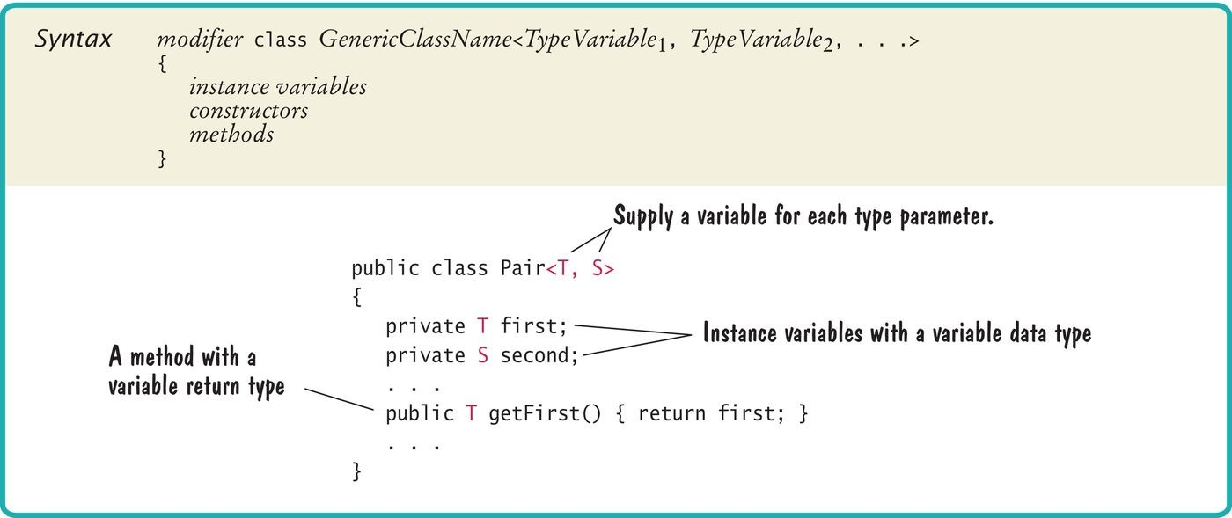
Syntax 18.1 Declaring a Generic Class

Slide 17
section_2/Pair.java
1 /**
2 This class collects a pair of elements of different types.
3 */
4 public class Pair<T, S>
5 {
private T first;
private S second;
8
9
/**

Slide 18
section_2/PairDemo.java
1 public class PairDemo
2 {
3 public static void main(String[] args)
4 {
String[] names = { "Tom", "Diana", "Harry" };
Pair<String, Integer> result = firstContaining(names, "a");
System.out.println(result.getFirst());
System.out.println("Expected: Diana");
System.out.println(result.getSecond());
Program Run:
Diana
Expected: Diana 1
Expected: 1

Slide 19
Self Check 18.6
How would you use the generic Pair class to construct a pair of strings
"Hello" and "World"?
Answer: new Pair<String, String>("Hello", "World")

Slide 20
Self Check 18.7
How would you use the generic Pair class to construct a pair containing
"Hello" and 1729?
Answer: new Pair<String, Integer>(“Hello”, 1729)

Slide 21
Self Check 18.8
What is the difference between an ArrayList<Pair<String, Integer>>
and a Pair<ArrayList<String>, Integer>?
Answer: An ArrayList<Pair<String, Integer>> contains multiple pairs, for example [(Tom, 1), (Harry, 3)]. A Pair<ArrayList<String>, Integer> contains a list of strings and a single integer, such as ([Tom, Harry], 1).

Slide 22
Self Check 18.9
Write a method roots with a Double parameter variable x that returns both the positive and negative square root of x if x ≥ 0 or null otherwise.
Answer:
public static Pair<Double, Double> roots(Double x)
{
if (x >= 0)
{
double r = Math.sqrt(x);
return new Pair<Double, Double>(r, -r);
}
else { return null; }
}

Slide 23
Self Check 18.10
How would you implement a class Triple that collects three values of arbitrary types?
Answer: You have three type parameters: Triple<T, S, U>. Add an instance variable U third, a constructor argument for initializing it, and a method U getThird() for returning it.

Slide 24
Generic Methods
Generic method: method with a type parameter. Can be declared inside non-generic class.
Example: Declare a method that can print an array of any type:
public class ArrayUtil
{
/**
Prints all elements in an array.
@param a the array to print
*/
public <T> static void print(T[] a)
{
. . .
}
. . .
}

Slide 25
Generic Methods
Often easier to see how to implement a generic method by starting with a concrete example.
Example: print the elements in an array of strings:
public class ArrayUtil
{
public static void print(String[] a)
{
for (String e : a)
{
System.out.print(e + " ");
}
System.out.println();
}
. . .
}

Slide 26
Generic Methods
In order to make the method into a generic method:
Replace String with a type parameter, say E, to denote the element type.
Add the type parameters between the method's modifiers and return type.
public static <E> void print(E[] a)
{
for (E e : a)
{
System.out.print(e + " ");
}
System.out.println();
}

Slide 27
Generic Methods
When calling a generic method, you need not instantiate the type variables:
Rectangle[] rectangles = . . .; ArrayUtil.print(rectangles);
The compiler deduces that E is Rectangle.
You can also define generic methods that are not static. You can even have generic methods in generic classes. Cannot replace type variables with primitive types.
Example: cannot use the generic print method to print an array of type int[]

Slide 28
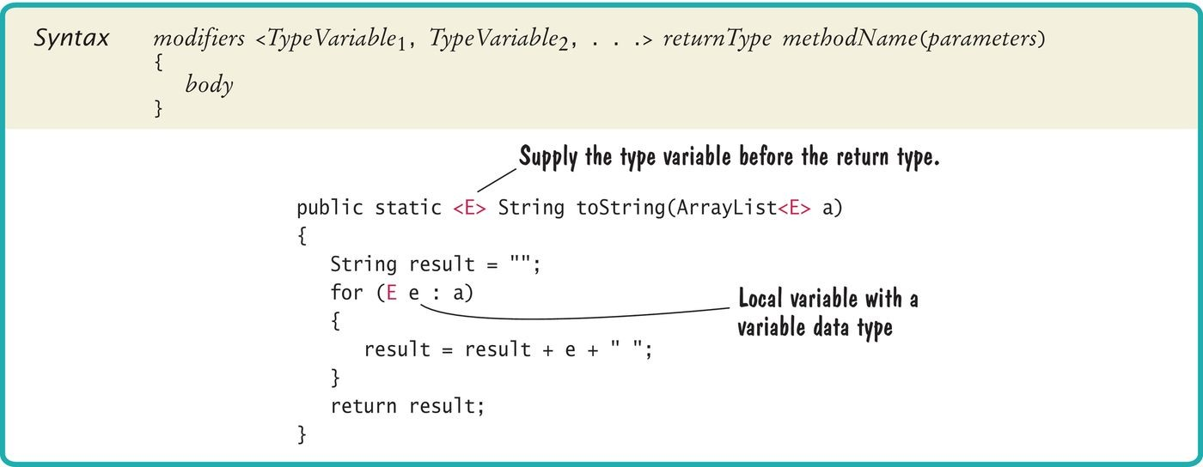
Syntax 18.2 Declaring a Generic Method

Slide 29
Self Check 18.11
Exactly what does the generic print method print when you pass an array of
BankAccount objects containing two bank accounts with zero balances?
Answer: The output depends on the definition of the
toString method in the BankAccount class.

Slide 30
Self Check 18.12
Is the getFirst method of the Pair class a generic method?
Answer: No – the method has no type parameters. It is an ordinary method in a generic class.

Slide 31
Self Check 18.13
Consider this fill method:
public static <T> void fill(List<T> lst, T value)
{
for (int i = 0; i < lst.size(); i++) { lst.set(i, value); }
}
If you have an array list ArrayList <String> a = new ArrayList<String>(10); how do you fill it with ten "*"?
Answer: fill(a, "*");

Slide 32
Self Check 18.14
What happens if you pass 42 instead of "*" to the fill method?
Answer: You get a compile-time error. An integer cannot be converted to a string.

Slide 33
Self Check 18.15
Consider this fill method:
public static <T> fill(T[] arr, T value)
{
for (int i = 0; i < arr.length; i++) { arr[i] = value; }
}
What happens when you execute the following statements?
String[] a = new String[10]; fill(a, 42);
Answer: You get a run-time error. Unfortunately, the call compiles, with T = Object. This choice is justified because a String[] array is convertible to an Object[] array, and 42 becomes new Integer(42), which is convertible to an Object. But when the program tries to store an Integer in the String[] array, an exception is thrown.

Slide 34

Constraining Type Variables
You can place restrictions on the type parameters of generic classes and methods.

Slide 35
Constraining Type Variables
Type variables can be constrained with bounds.
A generic method, average, needs to be able to measure the objects.
Measurable interface from Section 10.1:
public interface Measurable
{
double getMeasure();
}
We can constrain the type of the elements to those that implement the Measurable type:
public static <E extends Measurable> double average(ArrayList<E> objects)
This means, “E or one of its superclasses extends or implements Measurable”.
We say that E is a subtype of the Measurable type.

Slide 36
Constraining Type Variables
Completed average method:
public static <E extends Measurable> double average(ArrayList<E> objects)
{
if (objects.size() == 0) { return 0; } double sum = 0;
for (E obj : objects)
{
sum = sum + obj.getMeasure();
}
return sum / objects.size();
}
In the call obj.getMeasure()
It is legal to apply the getMeasure method to obj. obj has type E, and E is a subtype of Measurable.

Slide 37
Constraining Type Variables - Comparable Interface
Comparable interface is a generic type.
The type parameter specifies the type of the parameter variable of the compareTo method:
public interface Comparable<T>
{
int compareTo(T other);
}
String class implements Comparable<String>
A String can be compared to other String. But not with objects of a different class.

Slide 38
Constraining Type Variables - Comparable Interface
When writing a generic method min to find the smallest element in an array list,
Require that type parameter E implements Comparable<E>
public static <E extends Comparable<E>> E min(ArrayList<E> objects)
{
E smallest = objects.get(0);
for (int i = 1; i < objects.size(); i++)
{
E obj = objects.get(i);
if (obj.compareTo(smallest) < 0)
{
smallest = obj;
}
}
return smallest;
}
Because of the type constraint, obj must have a method of this form:
int compareTo(E other)
So the the following call is valid:
obj.compareTo(smallest)

Slide 39
Constraining Type Variables
Very occasionally, you need to supply two or more type bounds:
extends, when applied to type parameters, actually means “extends or implements.”
The bounds can be either classes or interfaces.
Type parameters can be replaced with a class or interface type.
<E extends Comparable<E> & Cloneable>

Slide 40
Self Check 18.16
How would you constrain the type parameter for a generic BinarySearchTree
class?
Answer:
public class BinarySearchTree<E extends Comparable<E>>
or, if you read Special Topic 18.1,
public class BinarySearchTree<E extends Comparable<? super E>>

Slide 41
Self Check 18.17
Modify the min method to compute the minimum of an array list of elements that implements the Measurable interface.
Answer:
public static <E extends Measurable> E min(ArrayList<E> objects)
{
E smallest = objects.get(0);
for (int i = 1; i < objects.size(); i++)
{
E obj = objects.get(i);
if (obj.getMeasure() < smallest.getMeasure())
{
smallest = obj;
}
}
return smallest;
}

Slide 42
Self Check 18.18
Could we have declared the min method of Self Check 17 without type parameters, like this?
Answer: No. As described in Common Error 18.1, you cannot convert an ArrayList<BankAccount> to an ArrayList<Measurable>, even if BankAccount implements Measurable.
public static Measurable min(ArrayList<Measurable> a)

Slide 43
Self Check 18.19
Could we have declared the min method of Self Check 17 without type parameters for arrays, like this?
Answer: Yes, but this method would not be as useful. Suppose accounts is an array of BankAccount objects. With this method, min(accounts) would return a result of type Measurable, whereas the generic method yields a BankAccount.
public static Measurable min(Measurable[] a)

Slide 44
Self Check 18.20
How would you implement the generic average method for arrays?
Answer:
public static <E extends Measurable> double average(E[] objects)
{
if (objects.length == 0) { return 0; } double sum = 0;
for (E obj : objects)
{
sum = sum + obj.getMeasure();
}
return sum / objects.length;
}

Slide 45
Self Check 18.21
Is it necessary to use a generic average method for arrays of measurable objects?
Answer: No. You can define
public static double average(Measurable[] objects)
{
if (objects.length == 0) { return 0; } double sum = 0;
for (Measurable obj : objects)
{
sum = sum + obj.getMeasure();
}
return sum / objects.length;
}
For example, if BankAccount implements Measurable, a BankAccount[] array is convertible to a Measurable[] array. Contrast with Self Check 19, where the return type
was a generic type. Here, the return type is double, and there is no need for using generic types.

Slide 46
Genericity and Inheritance
Common Error 18.1: One can not assign a subclass list to a superclass list.
ArrayList<SavingsAccount> is not a subclass of
ArrayList<BankAccount>.
Even though SavingsAccount is a subclass of BankAccount
ArrayList<SavingsAccount> savingsAccounts = new ArrayList<SavingsAccount>(); ArrayList<BankAccount> bankAccounts = savingsAccounts;
// Not legal - compile-time error
Common Error 18.2: However, you can do the equivalent thing with arrays:
SavingsAccount[] savingsAccounts = new SavingsAccount[10]; BankAccount bankAccounts = savingsAccounts; // Legal
But this assignment will give a run-time error:
BankAccount harrysChecking = new CheckingAccount(); bankAccounts[0] = harrysChecking; // Throws ArrayStoreException

Slide 47
Wildcard Types
Name | Syntax | Meaning
Wildcard with lower bound | ? extends B | Any subtype of B
Wildcard with upper bound | ? super B | Any supertype of B
Unbounded wildcard | ? | Any type

Slide 48
Wildcard Types
Wildcard types are used to formulate subtle constraints on type parameters.
A wildcard type is a type that can remain unknown.
A method in a LinkedList class to add all elements of
LinkedList other:
other can be of any subclass of E.
public void addAll(LinkedList<? extends E> other)
{
ListIterator<E> iter = other.listIterator(); while (iter.hasNext())
{
add(iter.next());
}
}
This declaration is too restrictive for the min method:
public static <E extends Comparable<E>> E min(E[] a)
Type parameter of the Comparable interface should be any supertype of the array list’s element type:
public static <E extends Comparable<? super E>> E min(E[] a)

Slide 49
Wildcard Types
A method in the Collections class which uses an unbounded wildcard:
static void reverse(List<?> list)
You can think of that declaration as a shorthand for:
static void <T> reverse(List<T> list)

Slide 50

Type Erasure
In the Java virtual machine, generic types are erased.

Slide 51
Type Erasure
The virtual machine erases type parameters, replacing them with their bounds or Objects.
For example, generic class Pair<T, S> turns into the following raw class:
public class Pair
{
private Object first; private Object second;
public Pair(Object firstElement, Object secondElement)
{
first = firstElement; second = secondElement;
}
public Object getFirst() { return first; } public Object getSecond() { return second; }
}

Slide 52
Type Erasure
Same process is applied to generic methods. In this generic method:
public static <E extends Measurable> E min(E[] objects)
{
E smallest = objects[0];
for (int i = 1; i < objects.length; i++)
{
E obj = objects[i];
if (obj.getMeasure() < smallest.getMeasure())
{
smallest = obj;
}
}
return smallest;
}
The type parameter Is replaced with its bound
Measurable:
public static Measurable min(Measurable[] objects)
{
Measurable smallest = objects[0];
for (int i = 1; i < objects.length; i++)
{
Measurable obj = objects[i];
if (obj.getMeasure() < smallest.getMeasure())

Slide 53
{
smallest = obj;
}
}
return smallest;
}

Slide 54
Type Erasure
Knowing about type erasure helps you understand limitations of Java generics.
You cannot construct new objects of a generic type.
For example, trying to fill an array with copies of default objects would be wrong:
public static <E> void fillWithDefaults(E[] a)
{
for (int i = 0; i < a.length; i++) a[i] = new E(); // ERROR
}
Type erasure yields:
public static void fillWithDefaults(Object[] a)
{
for (int i = 0; i < a.length; i++) a[i] = new Object(); // Not useful
}

Slide 55
Type Erasure
To solve this particular problem, you can supply a default object:
public static <E> void fillWithDefaults(E[] a, E defaultValue)
{
for (int i = 0; i < a.length; i++) a[i] = defaultValue;
}

Slide 56
Type Erasure
You cannot construct an array of a generic type:
public class Stack<E>
{
private E[] elements;
. . .
public Stack()
{
elements = new E[MAX_SIZE]; // Error
}
}
Because the array construction expression new E[] would be erased to new Object[].
One remedy is to use an array list instead:
public class Stack<E>
{
private ArrayList<E> elements;
. . .
public Stack()
{
elements = new ArrayList<E>(); // Ok
}
. . .
}

Slide 57
Type Erasure
Another solution is to use an array of objects and cast when reading elements from the array:
public class Stack<E>
{
private Object[] elements; private int currentSize;
. . .
public Stack()
{
elements = new Object[MAX_SIZE]; // Ok
}
. . .
public E pop()
{
size--;
return (E) elements[currentSize];
}
}
The cast (E) generates a warning because it cannot be checked at compile time.

Slide 58
Self Check 18.22
Suppose we want to eliminate the type bound in the min method of Section 18.5, by declaring the parameter variable as an array of Comparable<E> objects.
Why doesn't this work?
Answer:
public static <E> Comparable<E> min(Comparable<E>[] objects)
is an error. You cannot have an array of a generic type.

Slide 59
Self Check 18.23
What is the erasure of the print method in Section 18.3?
Answer:
public static void print(Object[] a)
{
for (Object e : a)
{
System.out.print(e + " ");
}
System.out.println();
}

Slide 60
Self Check 18.24
Could the Stack example be implemented as follows?
public class Stack<E>
{
private E[] elements;
. . .
public Stack()
{
elements = (E[]) new Object[MAX_SIZE];
}
. . .
}
Answer: This code compiles (with a warning), but it is a poor technique. In the future, if type erasure no longer happens, the code will be wrong. The cast from Object[] to String[] will cause a class cast exception.

Slide 61
Self Check 18.25
The ArrayList<E> class has a method:
Object[] toArray()
Why doesn't the method return an E[]?
Answer: Internally, ArrayList uses an Object[] array. Because of type erasure, it can’t make an E[] array. The best it can do is make a copy of its internal Object[] array.

Slide 62
Self Check 18.26
The ArrayList<E> class has a second method:
E[] toArray(E[] a)
Why can this method return an array of type E[]? (Hint: Special Topic 18.2.)
Answer: It can use reflection to discover the element type of the parameter a, and then construct another array with that element type (or just call the Arrays.copyOf method).

Slide 63
Self Check 18.27
Why can't the method
static <T> T[] copyOf(T[] original, int newLength)
be implemented without reflection?
Answer: The method needs to construct a new array of type
T. However, that is not possible in Java without reflection.

